Slide 1
Autobiographical motivation-
Self indulgence or inspiring self to greater heights
Clim Pacheco
Director, Business Transformation Solutions

Slide 2
Autobiographical motivation- ego trip or goal setting?
How writing an autobiography (for private reflection) can help motivate oneself to achieve career goals and life dreams
Self reflection and re-assessment of life goals through writing autobiographies at different stages of life (e.g. 30 years, 45 years, 60 years)
Autobiographical writing as a means of reflecting on ones emotional intelligence, propelling change within self and taking on leadership roles

Slide 3
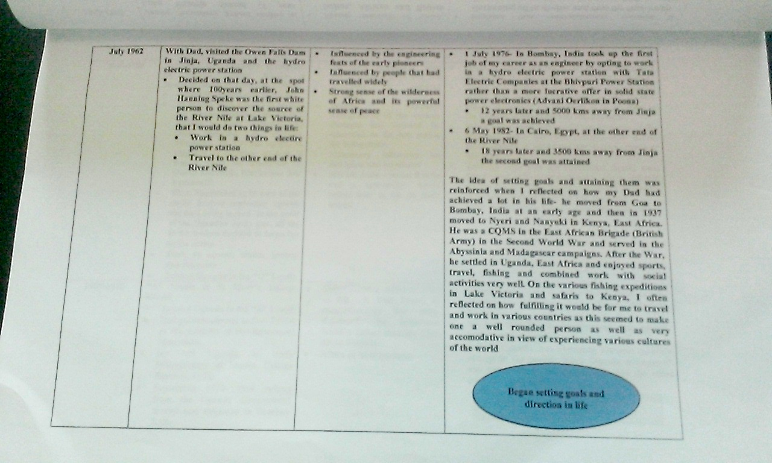
The question- what triggers change
Does the writing of an autobiography propel one to try new experiences in order to write about it?
OR
Does the challenge of trying new things make writing about it in an autobiography worthwhile?

Slide 4
The power of autobiographies
Writing autobiographies makes one think of:
  People who influence, shape and make a difference in ones life
  Events that shape ones present and future
  Places that have an impact on ones senses
  Friends who share experiences
  Family who are an integral part of ones journey through life
  Self and ones role in life and purpose
People
Events
Places
Self
Family
Friends

Slide 5
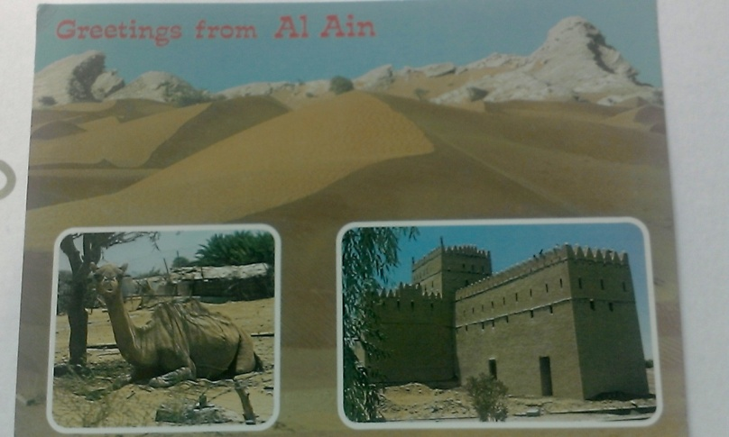
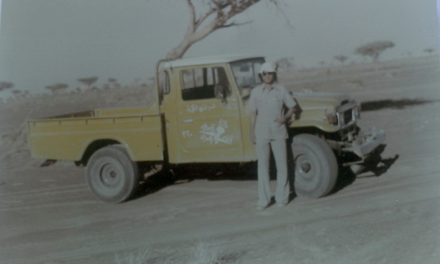
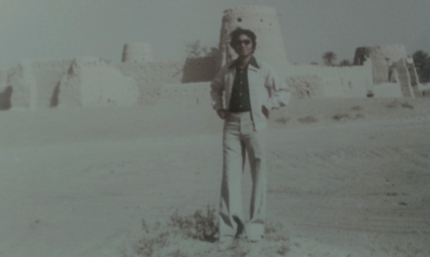
The autobiographical journey begins- UAE
Deserts of the UAE- Al Ain- 1982
The motivation:
  Questioning self
  Questioning cultural identity
  Questioning direction
  Questioning ambitions
  Recording for posterity

Slide 6
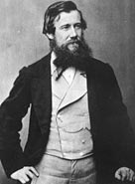
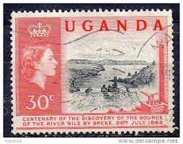
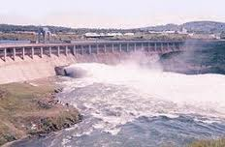
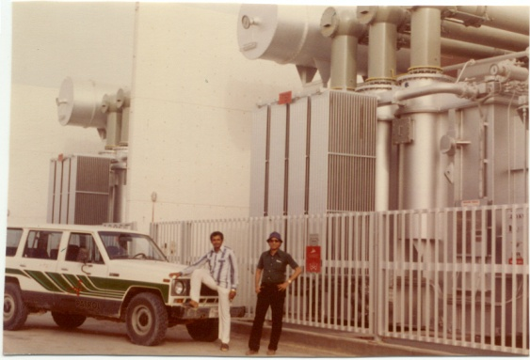
Reflections on the first career- engineering, 1982
Reflections on the past ambitions- Uganda, East Africa 1962
John Hanning Speke- discovery of the source of the River Nile at Ripon Falls, Lake Victoria, in 1862
Reflections on hydro power engineering , Tata Electric Companies, India
Reflections on power distribution and transmissions, Department of Water and Electricity, United Arab Emirates (UAE)

Slide 7
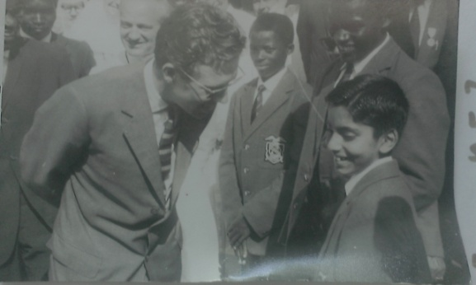
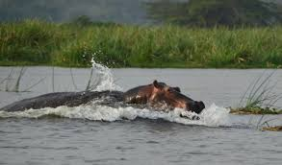


Reflections on self- west meets east
Reflection on self - western influences (Uganda) and eastern influences (India)
Untamed Africa and its influences
Reflection on future directions- a career in management till 45 years

Slide 8
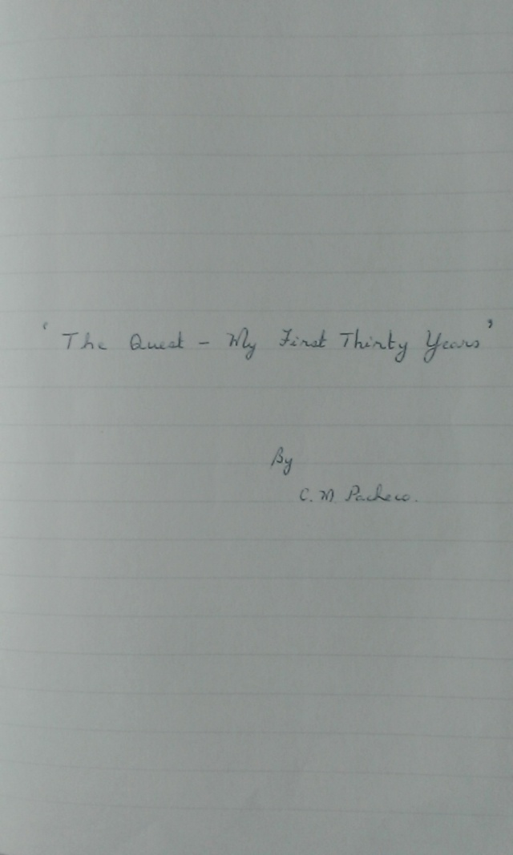
Captured in the first autobiography (30 years)
Thoughts and ambitions captured in the first autobiography- 30 years
Mental preparation for a new country (Australia) and career through analysis of strengths and weaknesses

Slide 9

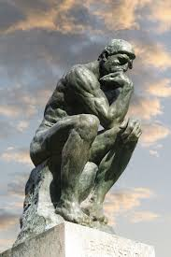
The next phase- 30 years to 45 years
Management studies to attain goal of moving to management, Monash University, MBA
From introversion towards extroversion- self awareness, social awareness
From engineering to management and leadership- the PTC and privatisation experience

Slide 10


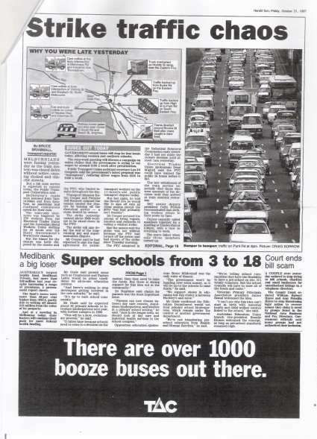
Reflections on the second career- management
Savouring management and leadership
Reflecting on change management, organisation restructures, strategic planning , team building, and conflict resolution
Analysing the move from engineering to management to develop an effective strategy to effect the next career change

Slide 11
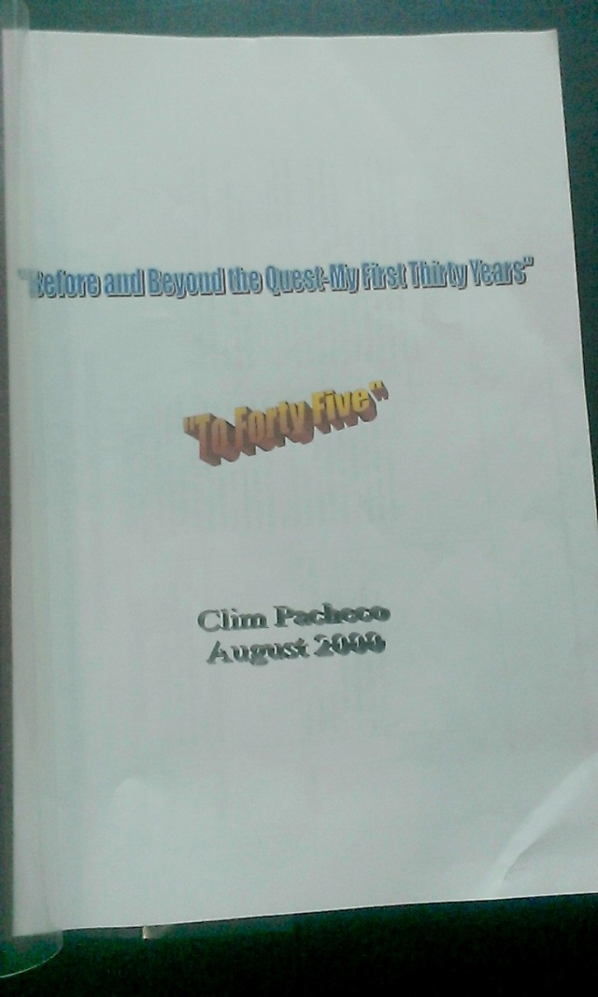
Captured in the second autobiography- 45 years
Thoughts and ambitions captured in the second autobiography- 45 years

Slide 12

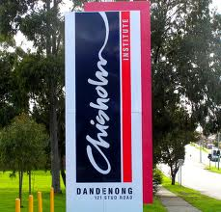
Preparation for the third career- education
Studies in education at University of Melbourne to attain goal of moving to education
Analysing the strengths to move to a new career in education

Slide 13
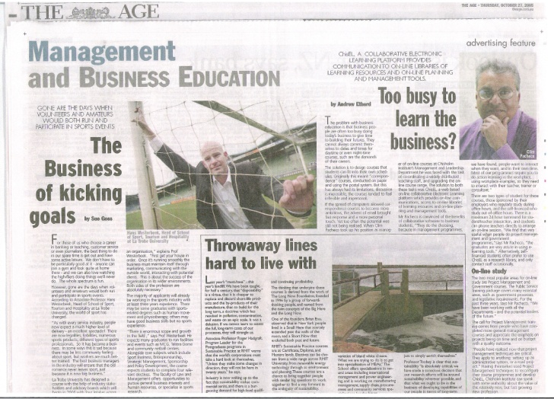
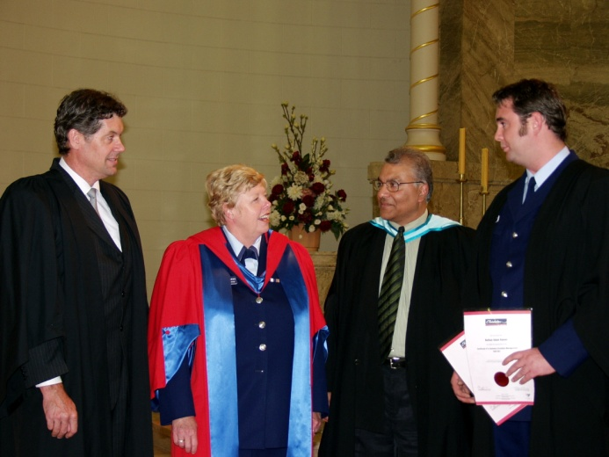
Reflections on the third career – management and leadership education, corporate consulting
Reflections on the third career- Chisholm Institute- management and leadership education
An Australia wide experience
The Karpin Report and Frontline Management experience

Slide 14

Preparation for the fourth career – risk management/ project management
Mental preparation for a new career in risk management and project management
A slight detour from risk management and project management- but back on track in later years

Slide 15
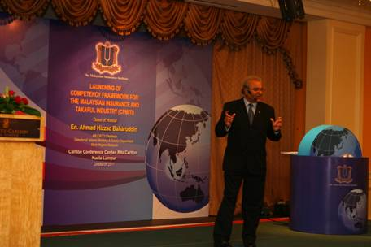
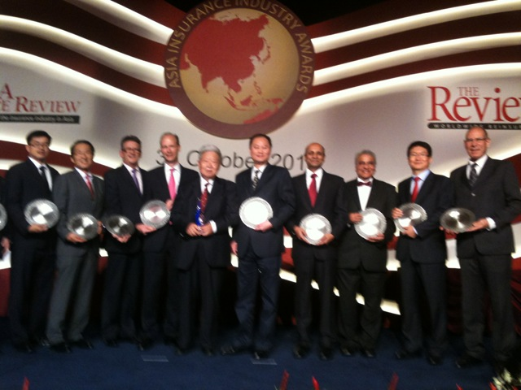
The fourth career- insurance and finance education (to 60years)
The ANZIIF insurance, finance, risk management education experience
A global perspective
Studies in Financial Planning

Slide 16
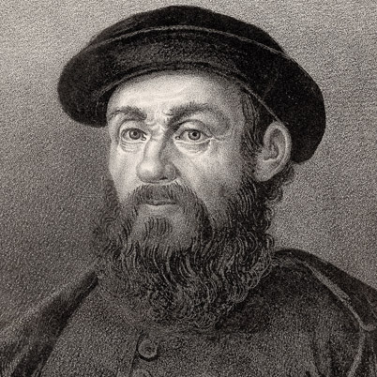
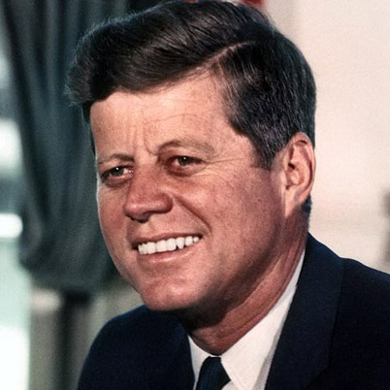
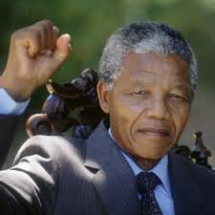
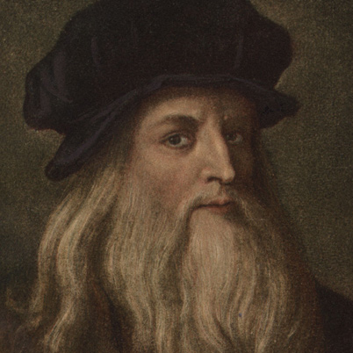
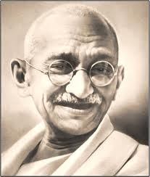
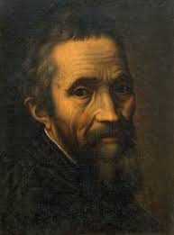
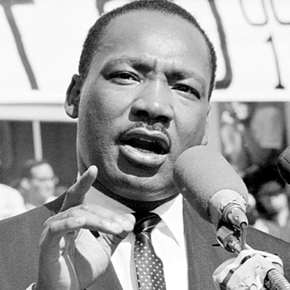
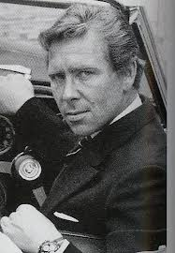
The influencers
Ferdinand Magellan John F Kennedy Nelson Mandela Leonardo Da Vinci
Mohandas Gandhi Michelangelo Martin Luther King Lord Snowdon

Slide 17
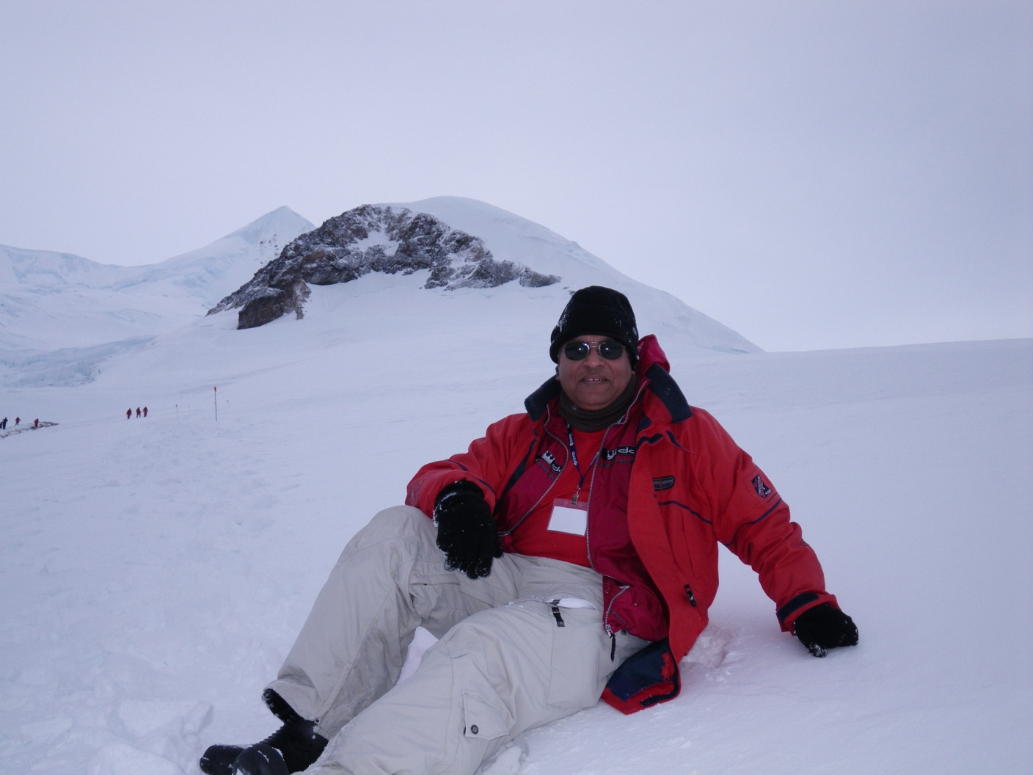
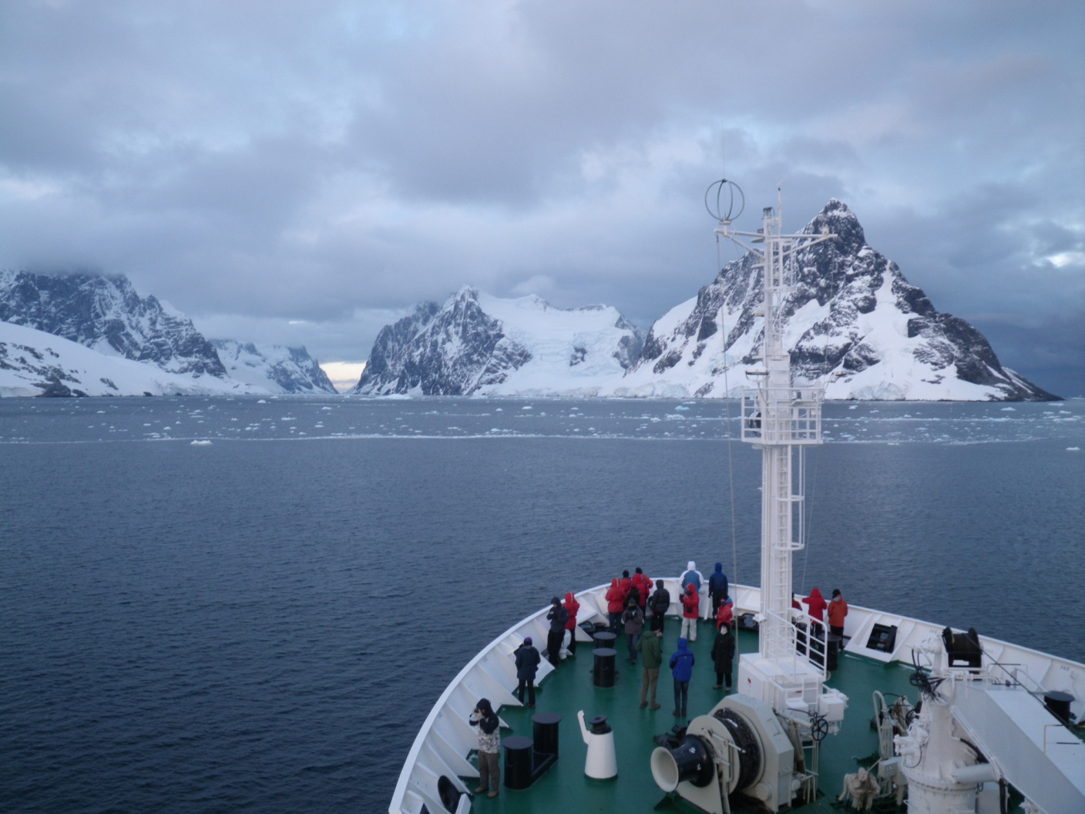
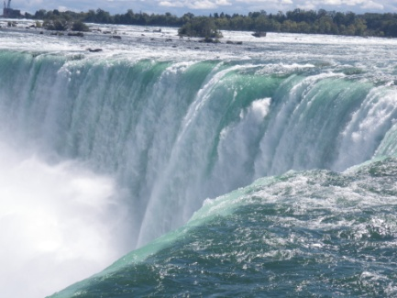
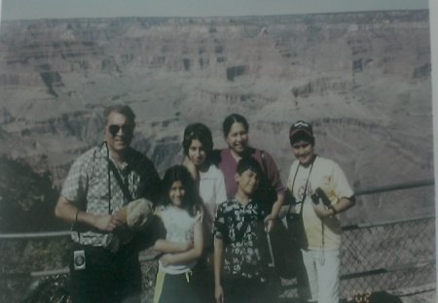
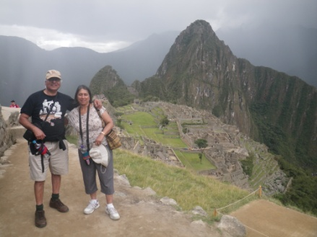

Personal ambitions- Antarctica, Grand Canyon, Niagara Falls, Machu Picchu and Harvard Business School
Personal fulfilment- camping on Antarctica, experiencing the power of the Niagara Falls, the Grand Canyon, Machu Picchu, Peru
Personal fulfilment- studying at Harvard Business School

Slide 18
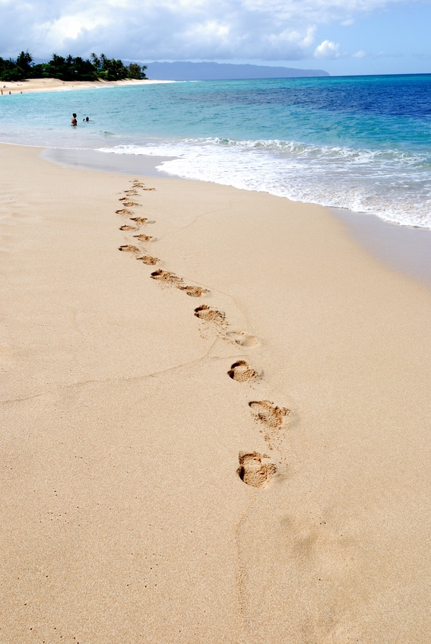
The fifth career- social and community work and consulting (60 years and beyond)
A new focus- social and community work
Volunteer work coupled with corporate consulting work
Balanced life style ambitions (work, family, leisure)

